Slide 1
Opening Arabic Restaurant in Paris
By: Taleb Bahadidah
August 2020

Slide 2
Agenda
Background
Introduction
Download and Explore Neighborhoods Dataset
Load and Analyze Venues of Neighborhoods in Paris
Cluster Neighborhoods using Agglomerative Clustering
Discussion & Results
Conclusion

Slide 3
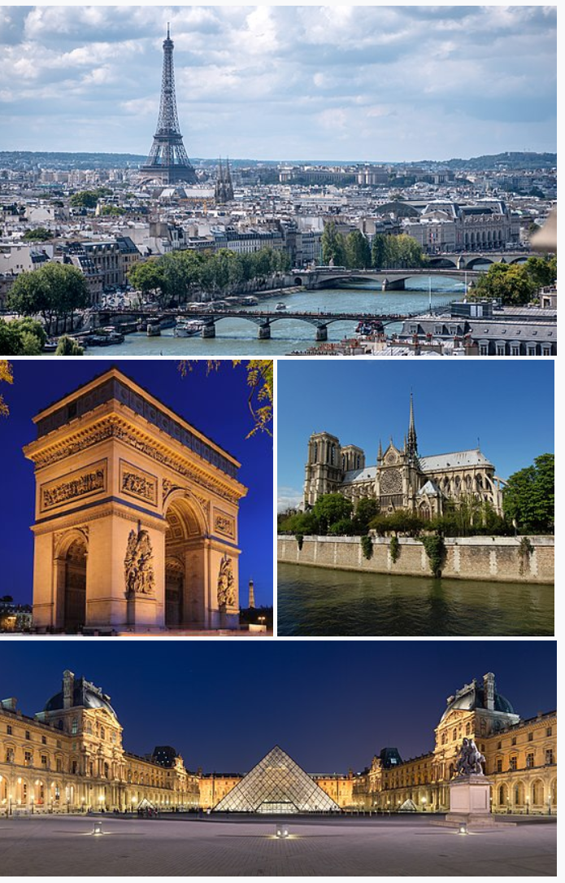
Background
Paris is the capital and largest city of France, as well as its cultural, industrial, and financial center. The geographical coordinate of Paris, France are 48.8566969, 2.3514616. Paris received 38 million visitors in 2019, measured by hotel stays. It was ranked as the second most visited travel destination in the world in 2019, after Bangkok and just ahead of London. Therefore, opening a restaurant in Paris will have a big opportunity to be a successful business.

Slide 4
Introduction
In this project, I will determine which place is good for opening Arabic Restaurant in Paris, France
I will convert address data into their equivalent latitude and longitude values.
For Paris neighborhood data, I will use Wikipedia https://en.wikipedia.org/wiki/Category:Districts_of_Paris
I will use the Foursquare API to explore Paris neighborhoods and to get venues in neighborhoods.
I will try to use the Foursquare API to get venue ratings and likes in neighborhoods (depending if there is rating available)
I will use the k-means clustering and Agglomerative algorithms to complete clustering task
I will use the Folium library to visualize the neighborhoods, venues, clusters in Paris

Slide 5
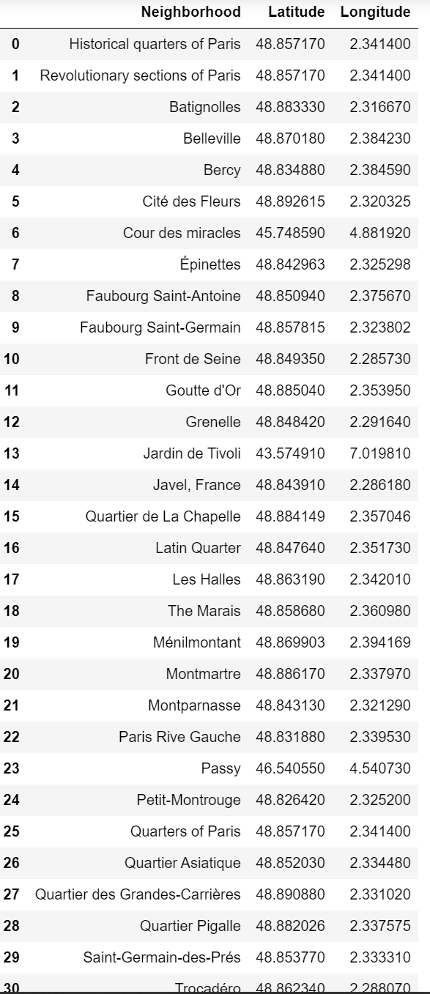
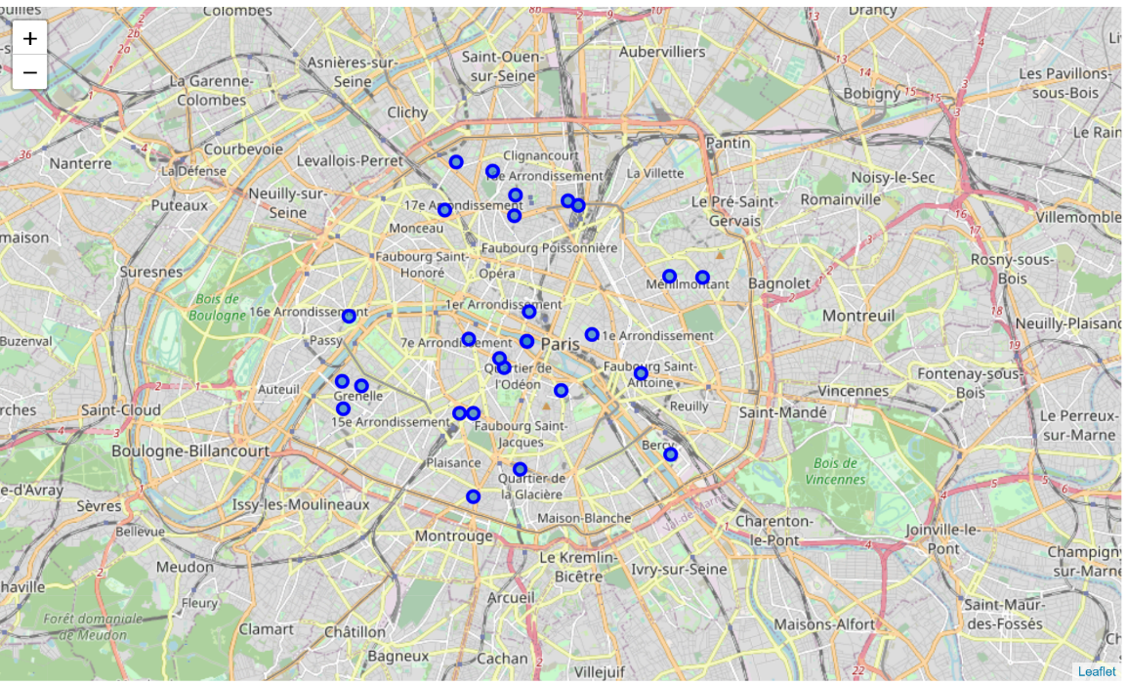
Download and Explore Neighborhoods Dataset
Paris map with neighborhoods superimposed
Cleaned datasets

Slide 6
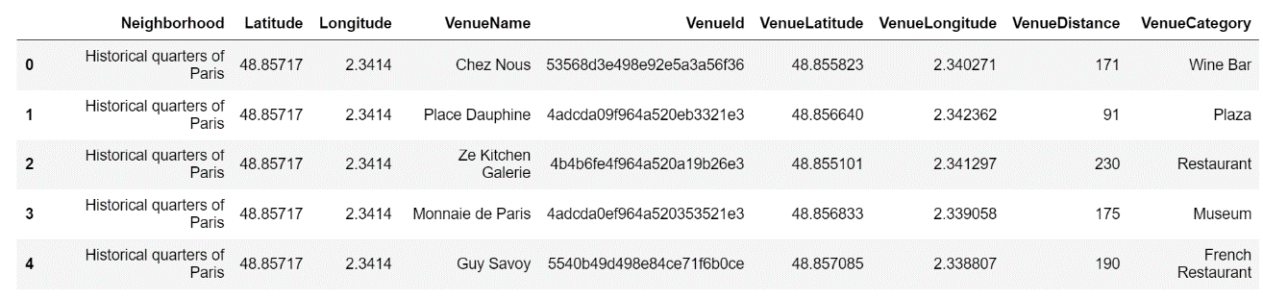
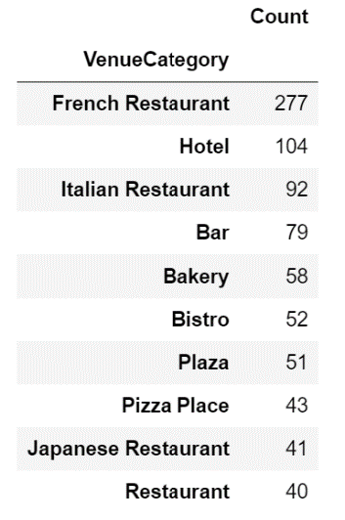
Load and Analyze Venues of Neighborhoods in Paris
venue list with 1 km distance to neighborhood's center
top 10 venue counts

Slide 7
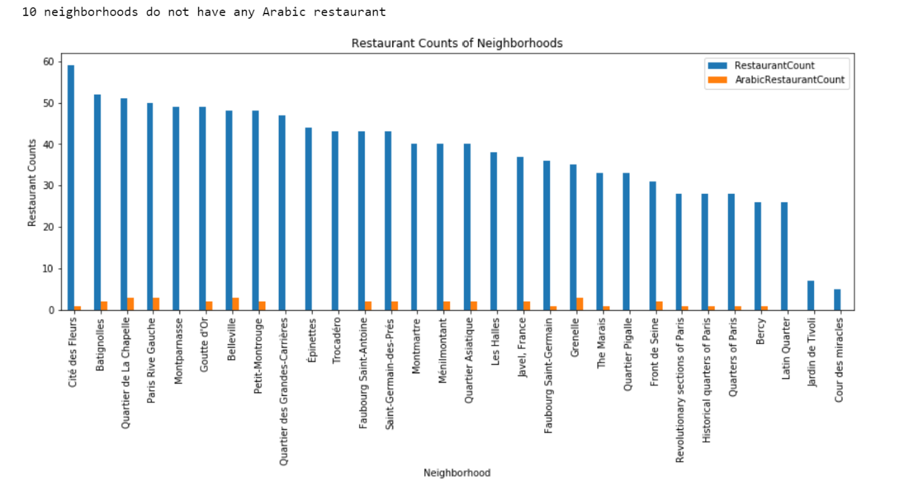
Load and Analyze Venues of Neighborhoods in Paris
I filtered All restaurants and Arabic restaurant. We can see from histogram of restaurants, 10 neighborhoods have no Arabic restaurant

Slide 8
Load and Analyze Venues of Neighborhoods in Paris
Cite des Fleurs is the neighborhood having most restaurants
Montparnasse, Quartier des Grandes, Epinettes and Trocadero have lots of restaurants, but no single Arabic restaurant
Jardin de Tvoli and Cour des miracles are neighborhoods having least number of restaurants
10 neighborhoods do not have any Arabic restaurant. we can choose one of these to open restaurant. To filter more let's continue

Slide 9
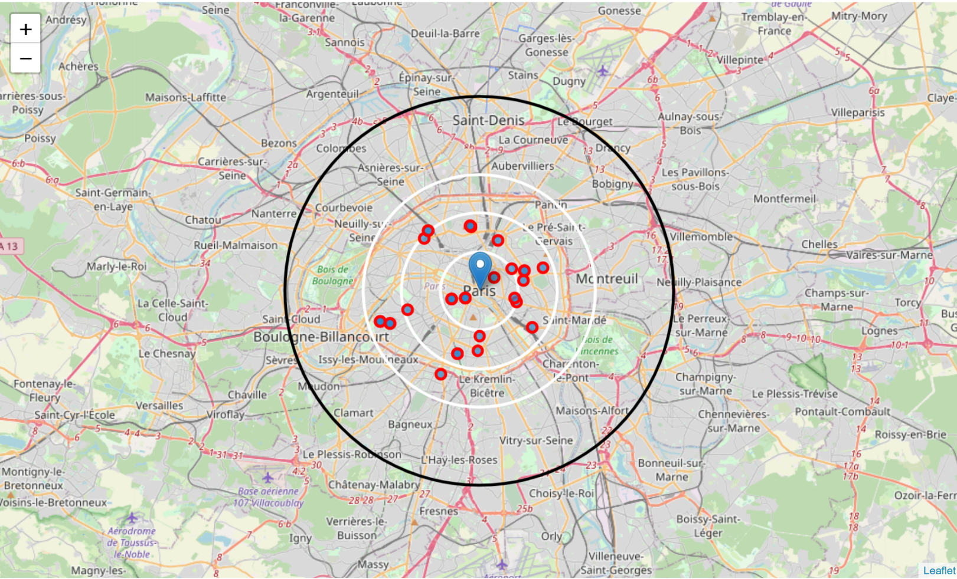
Load and Analyze Venues of Neighborhoods in Paris
Distribution of Arabic restaurants on Paris Map
Many restaurants in 4 km to the center
Enough restaurants between 4-6 km to the center
There are not any Arabic restaurants after 6 km to center
It looks hard to find location from this view as restaurant is scattered
Better maybe to filter by neighborhood and look for better chance

Slide 10
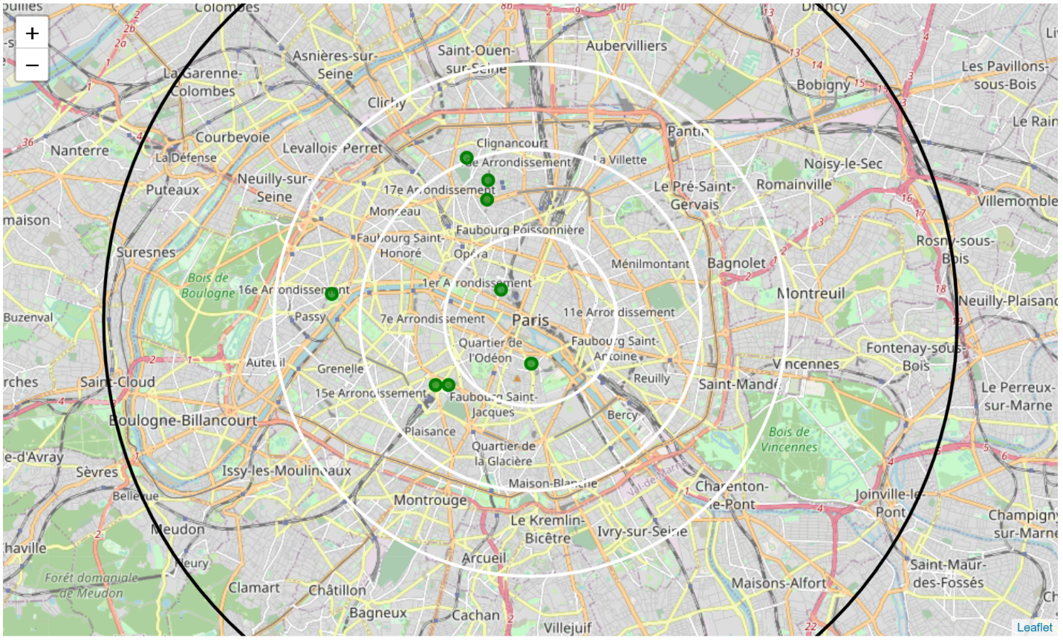
Load and Analyze Venues of Neighborhoods in Paris
neighborhoods which has no Arabic restaurant on map

Slide 11
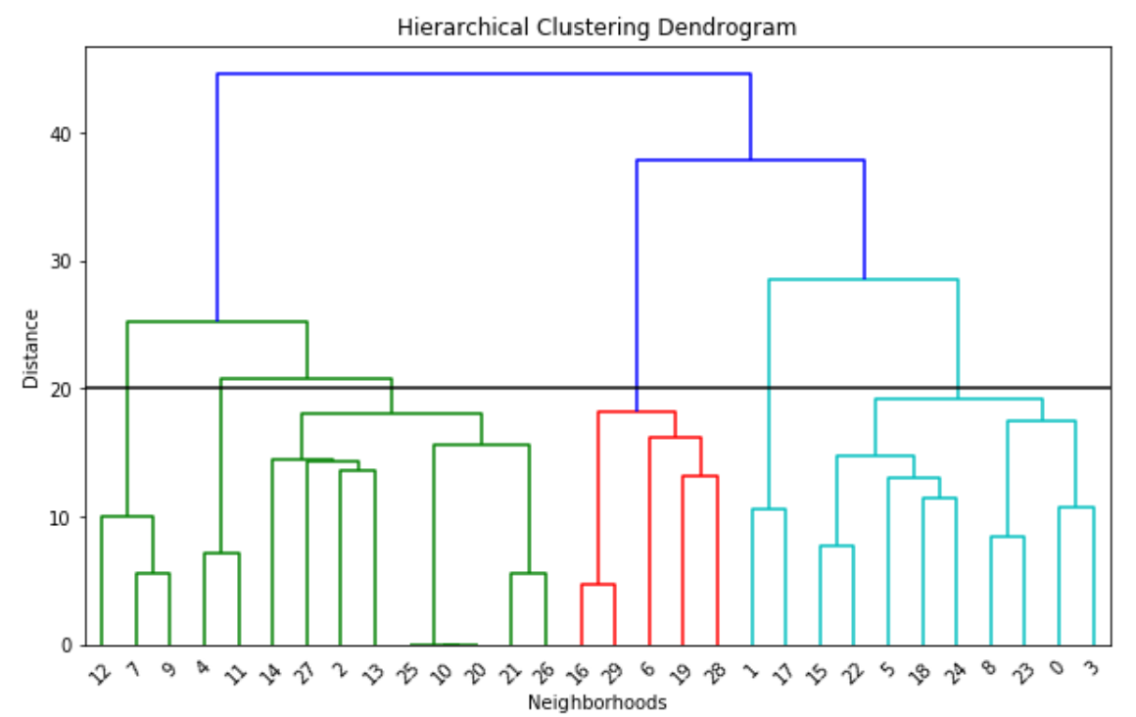
Cluster Neighborhoods using Agglomerative Clustering
I used Agglomerative Clustering to cluster neighborhoods according to count of venue categories in each neighborhood. According to the below graph, I decided to separate our neighborhoods into 6 clusters (cut at distance of 20, horizontal black line)

Slide 12
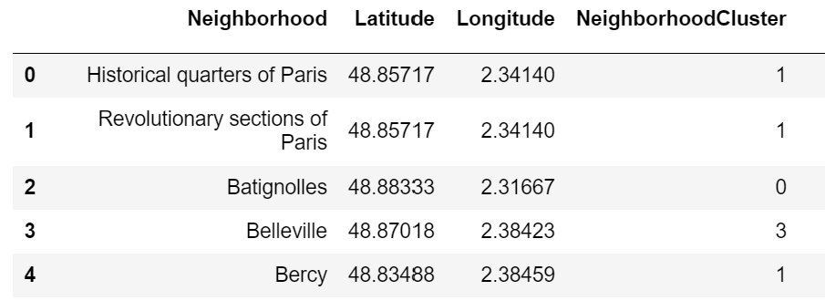
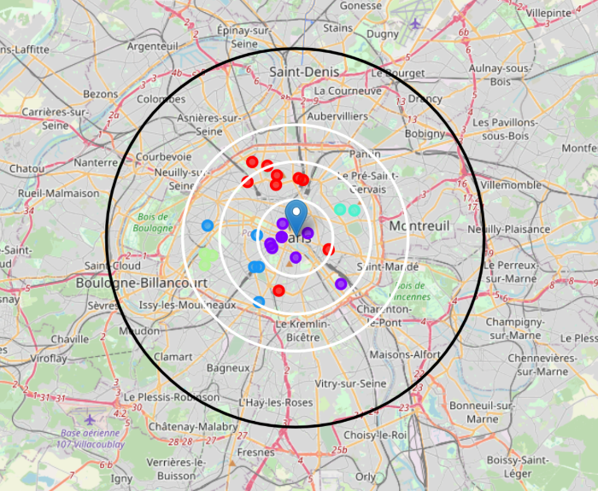
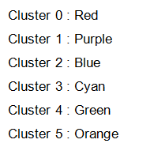
Clusters distribution across Paris map with data head and color coded

Slide 13
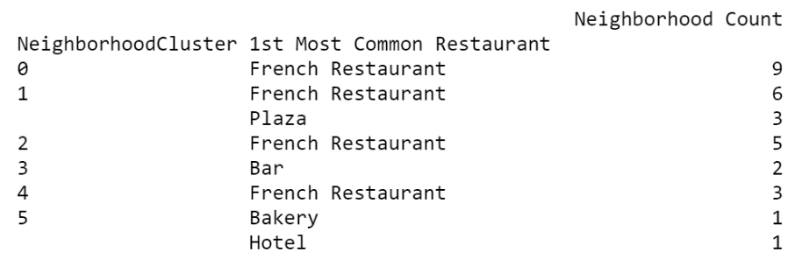
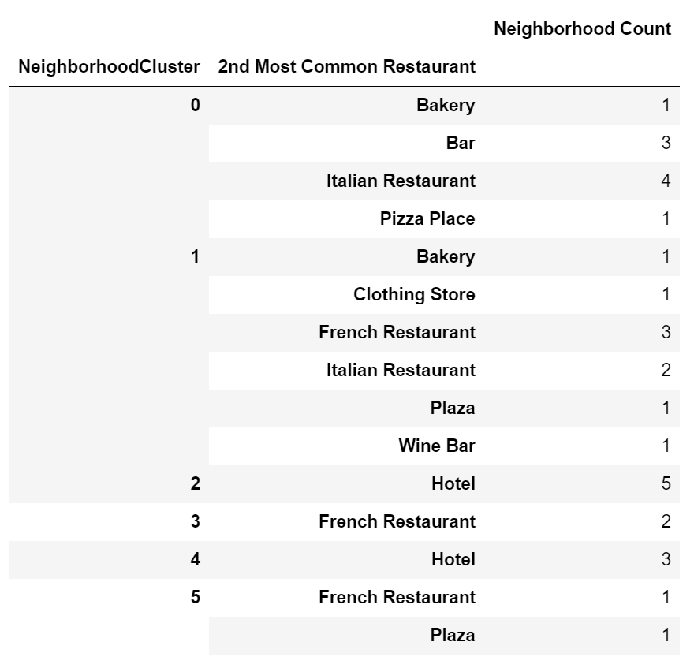
Clusters observation and analysis
Cluster 0 (Red): French and Italian Restaurant, Pizza, Bakery and Bar
Cluster 1 (Purple): French and Italian Restaurant, Clothing stores, Plaza
Cluster 2 (Blue): French Restaurant and Hotel
Cluster 3 (Cyan): French Restaurant, Bar
Cluster 4 (Green): French Restaurant and Hotel
Cluster 5 (Orange): Bakery and Hotel

Slide 14
Discussion & Results
Cluster 4 and 5 suffers from restaurant. Especially there is very less Arabic restaurant 4-6km from center and no after 6Km from center. We can think about Cluster 4 area
Cluster 0 especially likes French tastes, may be this part will not like Arabic tastes. We can only think about 1 location may be.
Cluster 1, 2, 3 are centers full of restaurants especially French and Italian so it maybe not a good idea.

Slide 15
Conclusion
Possible Neighborhoods to set up a Arabic restaurant:
Montparnasse, Quartier des Grandes, Epinettes and Trocadero have lots of restaurants, but no single Arabic restaurant
Since Montparnasse and Trocadero are the best as they located in Cluster 4 as explained above
Quartier des Grandes could be 2nd option to think about one location as it is located in cluster 0

